Slide 1

PRE-METRIC UNITS
In Rome!!

Slide 2

Length, distance and Area
In Ancient Rome, people would use feet to measure. Although people’s feet are different there would be a person in a shop who would measure. A foot is 29.6cm in ancient times.
To measure area they would just measure to side with feet is and multiply them by each other. Area would also be measured with the standard feet.

Slide 3

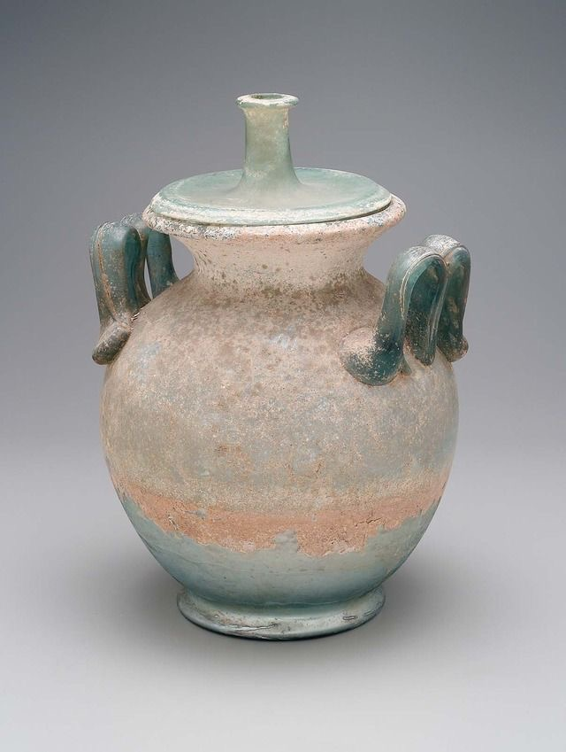
Volume and mass
To measure volume, they would use a “ master jar” . Every master jar would be exactly 1 cubic foot. Usually they need to measure volume when selling things like milk or water.
They would use the word Libra which is 329 grams per Libra. They would use a stone that is exactly 1 Libra and compare it to the object they are selling. It is usually used when selling meat.

Slide 4

THANK YOU!!!
:) :) :) :) :)

