Slide 1
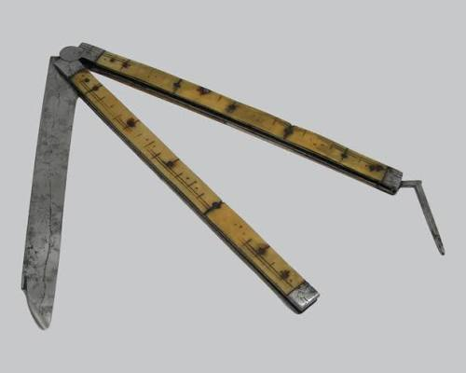

Pre metric-units of FRANCE
Before metric units was invented France used around 250,000 different local definitions.
Pied du Roi Was a common unit used by scientists in Paris measuring roughly 32.48cm,

Slide 2
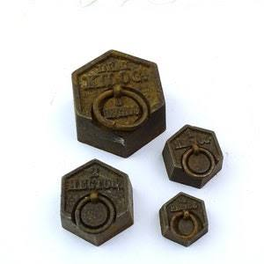

Importance of pre metric units in France
The pre-metric system was a symbol of the Old Regime: localized, unequal, and confusing. Its replacement by the metric system wasn't just a change in math; it was a democratic revolution that turned "subjects" into "citizens" by giving everyone the same standard of truth in the marketplace.
Images of pre metric units.

