Slide 1

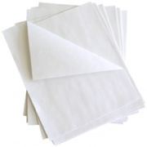

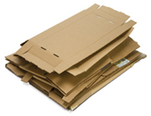
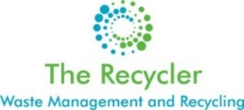
BRAEBURN
Recycling Report
February 2024
Paper
Cardboard
Glass
= 10 kilograms
= 5 kilograms
= 20 bottles
= 140 bottles recycled
( 78 kilograms)
= 49 Kilograms recycled
= 21 Kilograms recycled

Slide 2
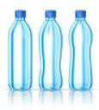
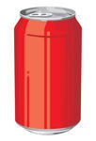
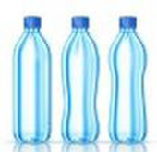
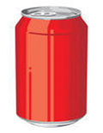
BRAEBURN
Recycling Report
Plastic Bottles
Cans/Tins
= 100 bottles
= 20 cans
= 931 bottles recycled
( 27 kilograms)
= 229 cans recycled
( 8 kilograms)

Slide 3
Monthly Comparison
(Kilograms Recycled)
Month | Paper | Cardboard | Plastic bottles | Cans | Glass | Total (in Kilograms)
May | 37 | 37 | 26 | 9 | 70 | 179
June | 40 | 37 | 18 | 8 | 137 | 240
July | 45 | 20 | 11 | 4 | 49 | 129
August | 20 | 9 | 13 | 9 | 17 | 68
September | 33 | 25 | 19 | 7 | 70 | 154
October | 22 | 19 | 15 | 8 | 38 | 102
November | 32 | 17 | 14 | 4 | 28 | 95
December | 30 | 29 | 23 | 8 | 50 | 140
January 2024 | 24 | 29 | 14 | 7 | 55 | 129
February | 49 | 21 | 27 | 8 | 78 | 183
*TOTAL | 593 | 301 | 328 | 127 | 1,050 | 2,399
*Total since beginning of collections

Slide 4
BRAEBURN
Recycling Report

Slide 5

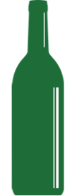
Recycling Facts
All Cardboard and white paper went to a local manufacturer that turns it into toilet paper rolls and brown envelopes.
Paper products omit serious amounts of methane when placed in a landfill to decay.
Plastic bottles are shredded in Dar es Salaam into flakes and then a portion are made into fiber in Tanzania. Others are exported to Europe or South Africa. These are then used to make new plastic bottles, plastic chairs, berry containers or even shirts or jackets.
1 recycled plastic bottle saves enough energy to power a 60-watt light bulb for three hours.
Cans went to a local company that will melt it down into new metal products like steel frames and bars
• One recycled can saves enough energy to power a television for 3 hours.
• Aluminum cans can be recycled and ready to use in just 6 weeks.
Glass went to a local manufacturer that crushes the glass and reheats it to make new bottles.
• Glass is 100% recyclable and can be used again and again
• Glass that ends up in landfills will never decompose

Slide 6
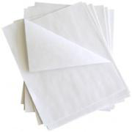
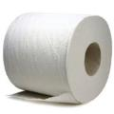
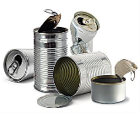
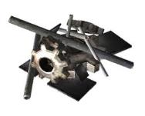
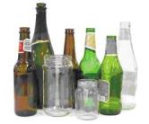
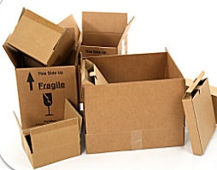

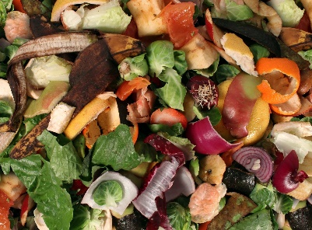
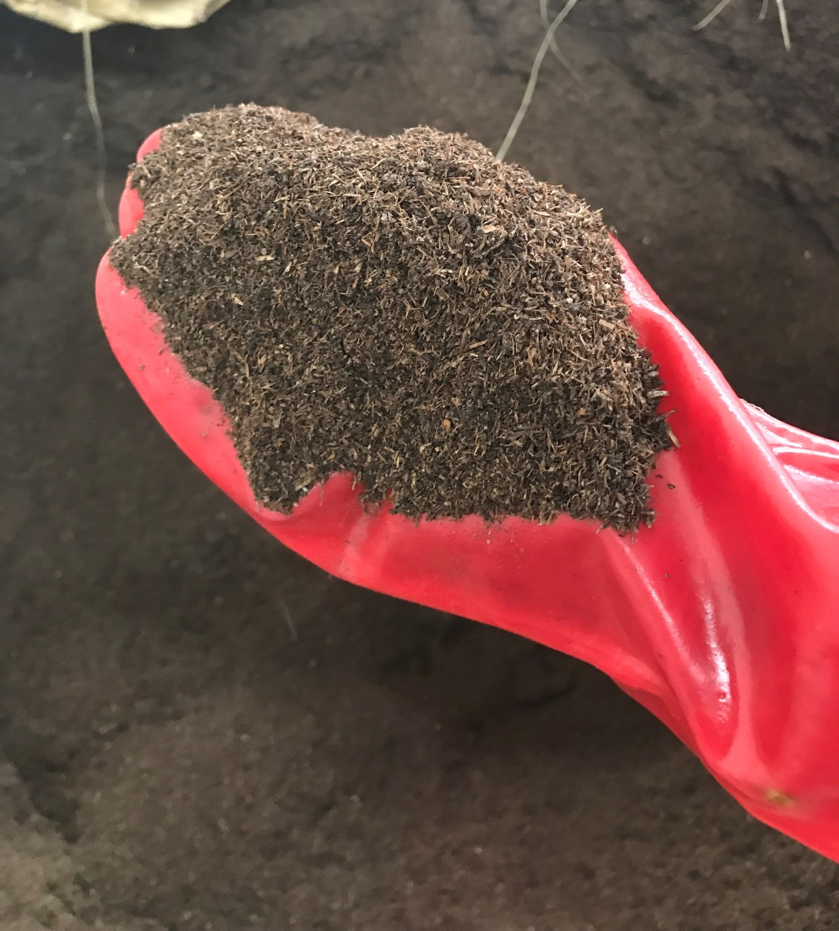
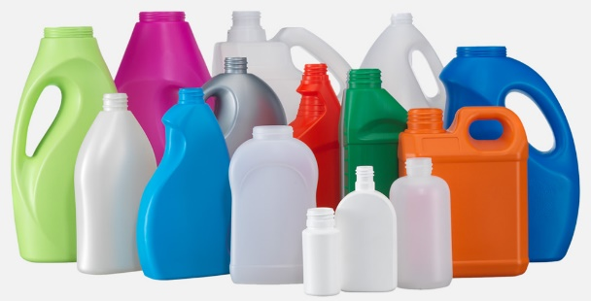
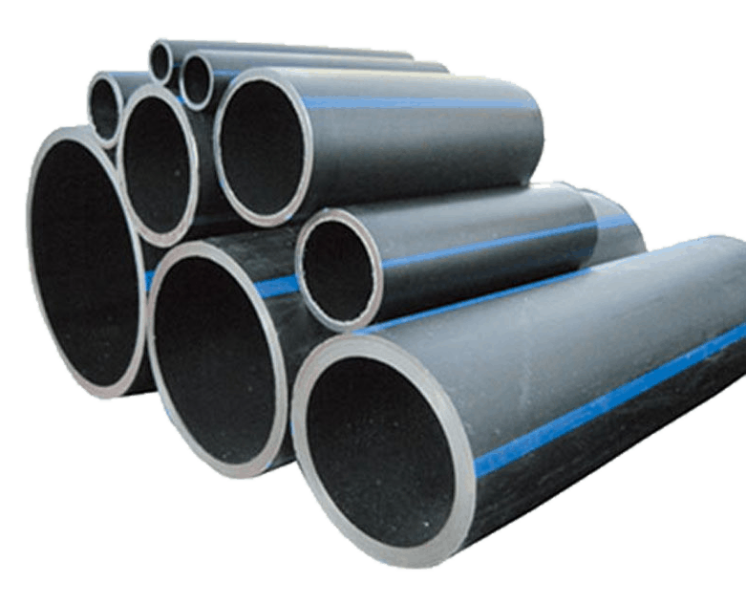
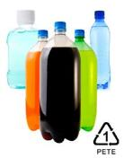
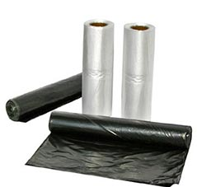
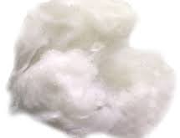

Recyclables – majority locally processed
=
=
=
=
=
=
=
=

Slide 7


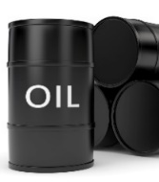



Recycling Impact
  Since becoming a Recycler in May 2022 Braeburn has recycled 2,399 kgs of waste!
Recycling the equivalent of 11,310 one-liter plastic bottles
Recycling the equivalent of 1,875 glass bottles
Recycling the equivalent of over 3,629 cans
Recycling of white paper and cardboard has saved 15 trees!
Recycling plastic has saved the equivalent of 20 barrels of oil
Recycling has saved the equivalent of 7 tons of CO₂
Recycling has saved 12 cubic meters of landfill space
Recycling has saved 23,689 liters of water!
Notes:
1 Litre Plastic Bottle - 29 grams
1 Can - 35 grams
1 wine bottle - 560 grams
Paper to trees – 17 per 1 ton
1 ton of recycling = 2.97 tons of C02 – EPA https://www.epa.gov/energy/greenhouse-gas-equivalencies-calculator-revision-history
Water –recycling 1 ton of paper saves around 682.5 gallons of oil, 26,500 litres of water and 17 treeshttps://www.unsustainablemagazine.com/using-recycled-paper-is-not-just-about-saving-trees/

Slide 8
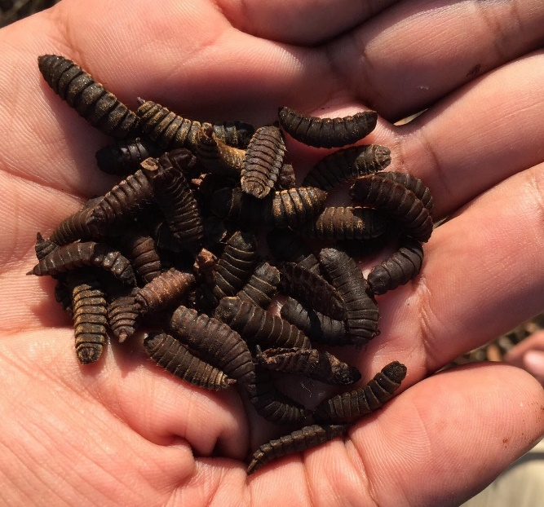
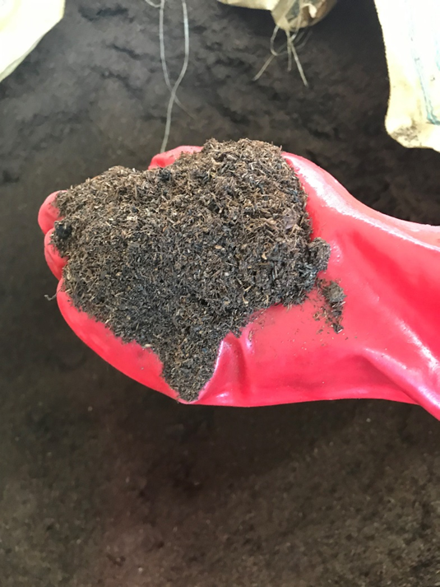
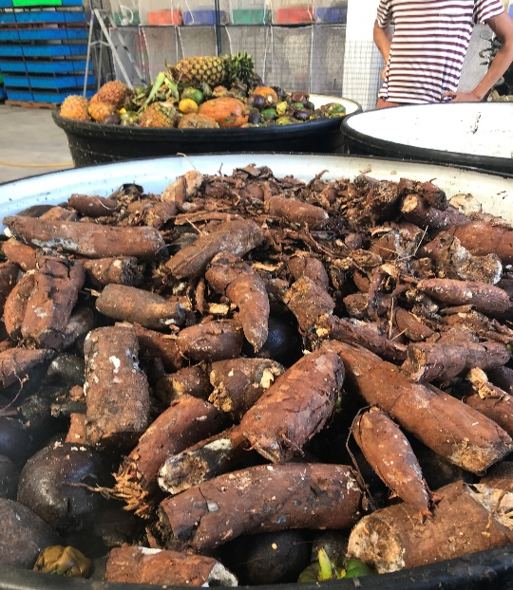


Check out our Food Waste to maggot feed and compost project!
Interested in some organic compost for your garden?
https://www.instagram.com/the_recycler_tanzania/
www.facebook.com/biobuu

