Slide 1


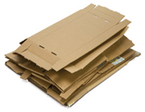
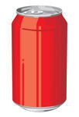
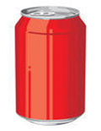

BRAEBURN
Recycling Report
November 2022
Paper
Cardboard
Cans/Tins
= 5 kilograms
= 5 kilograms
= 20 cans
= 5 Kilograms recycled
= 229 cans recycled
(8 kilograms)
= 36 Kilograms recycled

Slide 2




BRAEBURN
Recycling Report
Plastic Bottles
Glass
= 50 bottles
= 10 bottles
= 104 bottles recycled
(58 kilograms)
= 552 bottles recycled
(16 kilograms)

Slide 3

BRAEBURN
Recycling Report

Slide 4
Monthly Comparison
(Kilograms Recycled)
Month | Paper | Cardboard | Plastic bottles | Cans | Glass | Total (in Kilograms)
May 2022 | 27 | 3 | 7 | 2 | 36 | 75
June | 11 | 0 | 1 | 0 | 15 | 27
July | 11 | 0 | 5 | 2 | 43 | 61
August | 0 | 0 | 0 | 0 | 0 | 0
September | 10 | 0 | 4 | 1 | 32 | 47
October | 3 | 0 | 2 | 0 | 7 | 12
November | 36 | 5 | 16 | 8 | 58 | 123
TOTAL | 98 | 8 | 35 | 13 | 191 | 345

Slide 5


Recycling Facts
All Cardboard and white paper went to a local manufacturer that turns it into toilet paper rolls and brown envelopes.
Paper products omit serious amounts of methane when placed in a landfill to decay.
Plastic bottles were given to local traders who process them into flakes and then export them to India. These are then used to make new plastic bottles, plastic chairs or even shirts or jackets.
1 recycled plastic bottle saves enough energy to power a 60-watt light bulb for three hours.
Cans went to a local company that will melt it down into new metal products like steel frames and bars
• One recycled can saves enough energy to power a television for 3 hours.
• Aluminum cans can be recycled and ready to use in just 6 weeks.
Glass went to a local manufacturer that crushes the glass and reheats it to make new bottles.
• Glass is 100% recyclable and can be used again and again
• Glass that ends up in landfills will never decompose

Slide 6
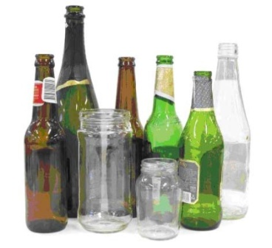

How long does it take to decompose in a landfill if not recycled?
Two months
500 years
80 Years
1 million years
Thank you for being a RECYCLER

Slide 7
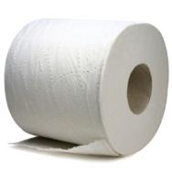

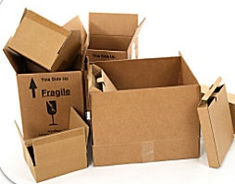
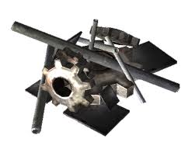

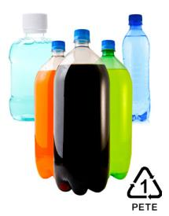
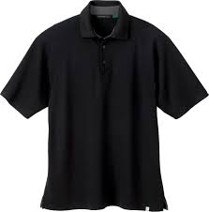
Where does it go
=
=
=
=
=

Slide 8
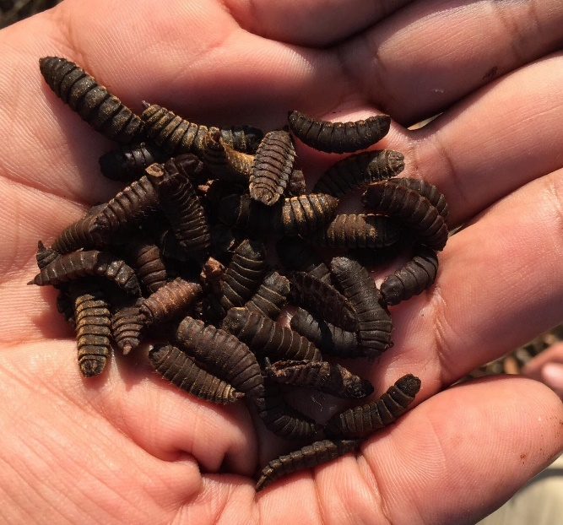
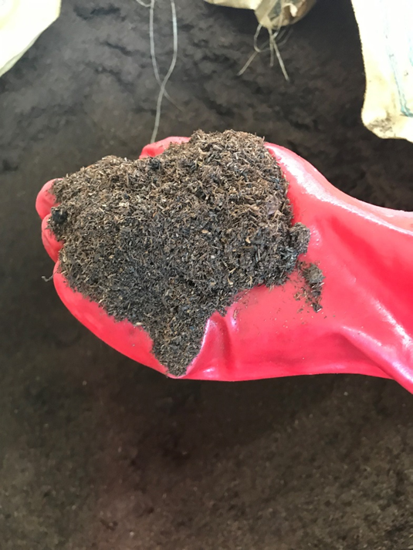
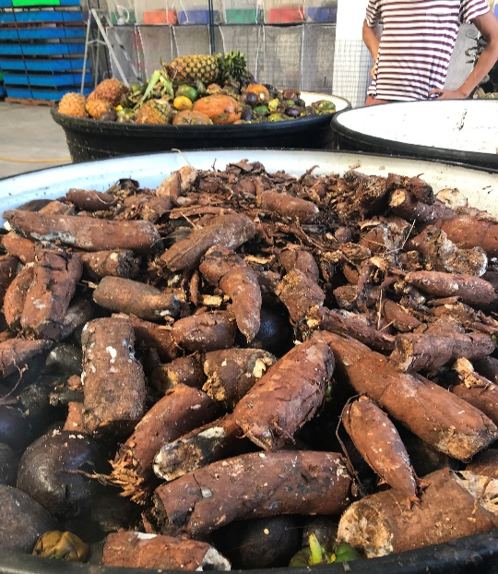


Check out our Food Waste to maggot feed and compost project!
Interested in some organic compost for your garden?
www.instagram.com/biobuu/
www.facebook.com/biobuu

