Slide 1
A Parent Workshop
for children in Year 1 through to Year 3
Facilitated by Miss Igogo
29th September 2022

Slide 2
Aims of this workshop:
To understand what is reading for meaning.
To understand why reading for meaning is so important.
To be aware of how reading for meaning is implemented in the classroom.
To explain how you can support your child to read for meaning at home.

Slide 3
Reading for Meaning:
A reading strategy that focuses on understanding what is read and finding meaning within it.
It focuses on two types of questions: literal and inferential.
Enables children to answer literal questions about a text and make inferences from it.
Helps them to make sense of challenging texts and read critically.
Focuses on intepreting a text based on evidence.

Slide 4
Literal Questions:
Focuses on the who, what, where, and when of a text. Readers can find the answers to literal questions in the words and pictures of a text. These do not leave room for interpretation.
Examples:
Who was building the tower?
Where did the story take place?

Slide 5
Inferential Questions:
Requires readers to search for context clues in the text where answers cannot be directly found but are supported by evidence in a text.
Examples:
Explain why the character acted in the way they did?
What kind of people would read this text?

Slide 6
Why read for meaning?
Reading for meaning skills can help prepare children for what they might read later on in their education.
As they grow, they'll be faced with more challenging texts with challenging vocabulary. If they aren't able to read and analyse texts for meaning, they will struggle and become discouraged, which in turn will demotivate them.

Slide 7
How reading develops:
Sing the
ABCs
Learn the relationship between letters and sounds.
Read silently without vocalising.
Read to gain ideas and knowledge.
Comprehend longer texts, such as books.

Slide 8
Reading for meaning at school:
Reading texts are assigned alongside a set of literal questions. Here, children are encourage to be detectives and find evidence for their answers from a text.
Children are encouraged to use quotes and even reference page numbers to support their answers.

Slide 9
Reading for meaning at school:
Once confident, children answer inferential or open-ended questions. They learn to make meaning and think deeply. For example, “How do you think the character felt during this scene?” or “What do you think will happen next?” Here, they learn to defend their arguments or explain their thinking.

Slide 10
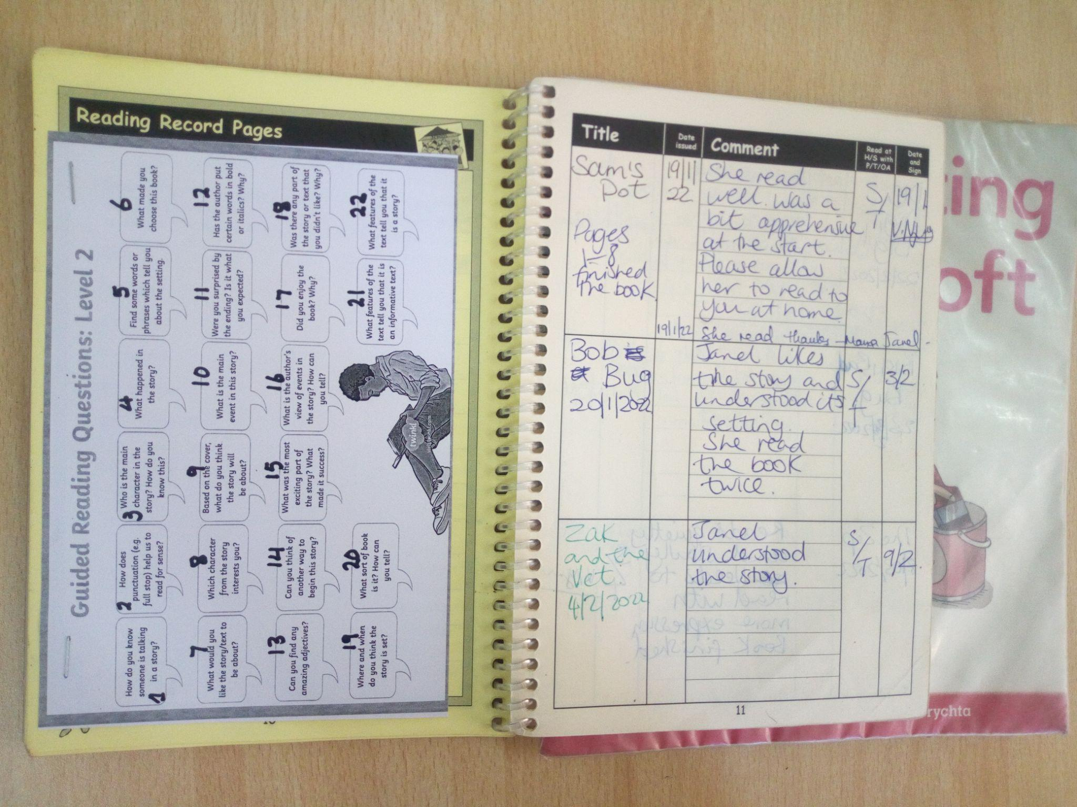
Reading For Meaning at school.

Slide 11
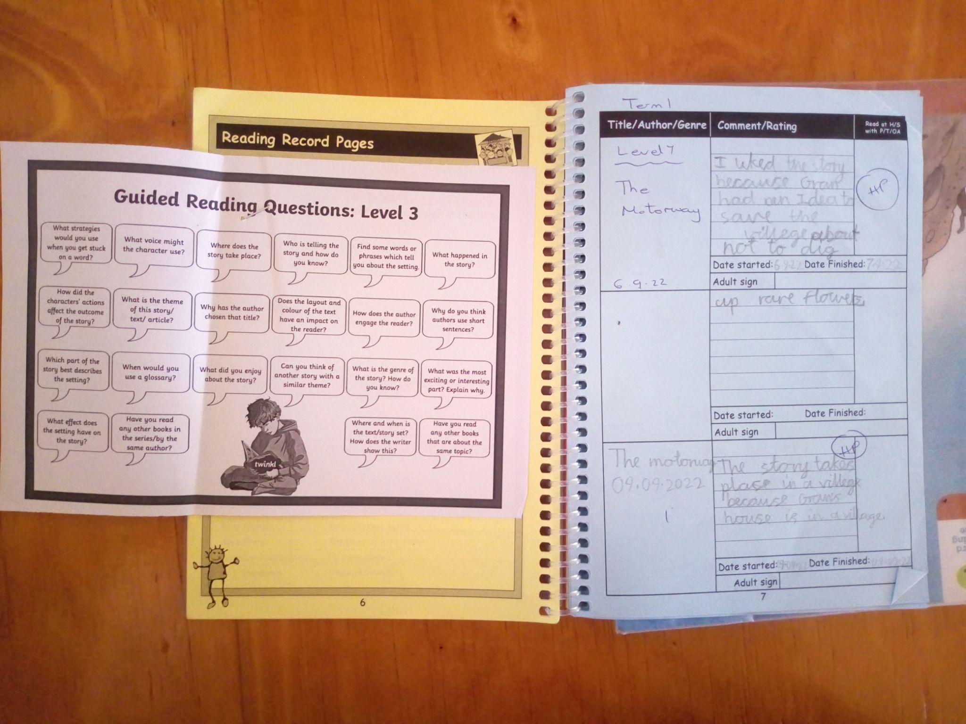
Reading For Meaning at School

Slide 12
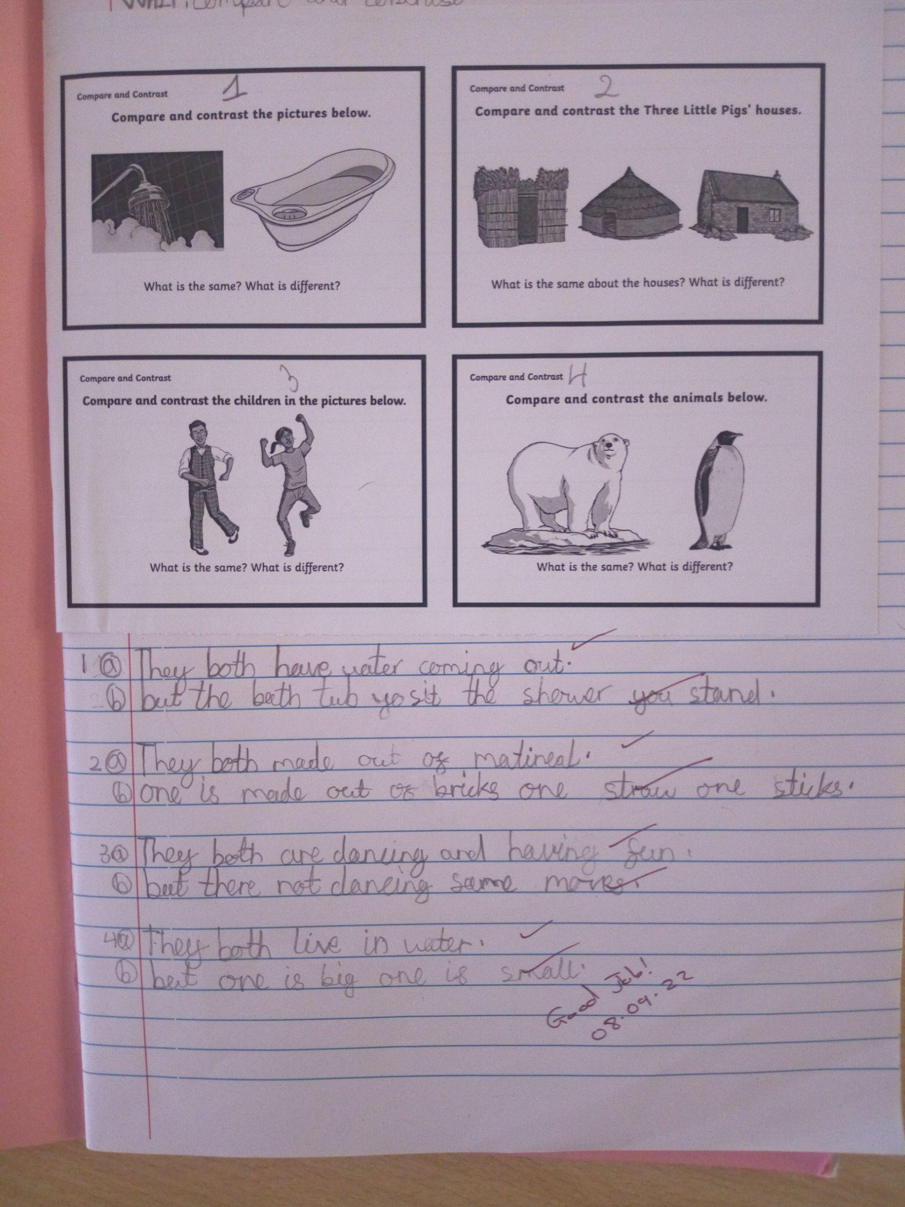
Read for Meaning at School

Slide 13
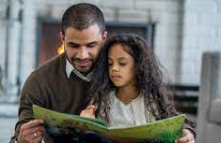
Support reading for meaning at home:
Please refer to the handout on your table:
Top Tips for reading with your child at home.
Questions to ask your child when reading together.
How to use the Reading Log.

Slide 14
Online Resources:
https://www.oxfordowl.co.uk/ (Lots of free ORT books)
https://storylineonline.net/
https://reading.ecb.org/
https://kids.getepic.com/
Britannica: https://school.eb.co.uk/?target=%2Flevels
Username: braeburngroup
Password: braeburnonline

Slide 15
Any questions?

